Slide 1
General Formula
What is the functional group for alcohol?
OH
2. What is the general formula for alcohols?
C_{n}H_{2n+1}OH
3. How can we shorten this formula?
ROH
Notes:
MBW

Slide 2
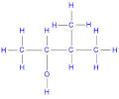
Naming Alcohols…
Name the following alcohols…
1
2
3
4

Slide 3
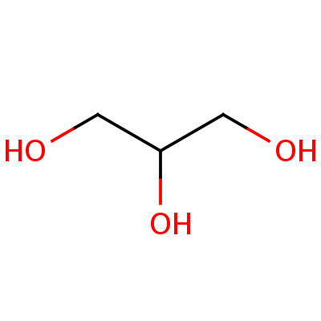
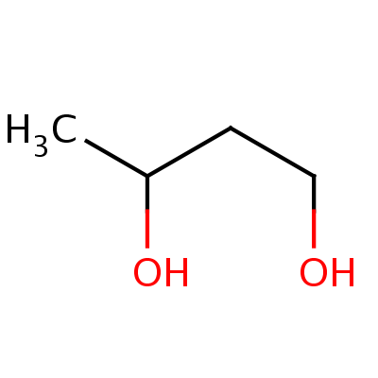
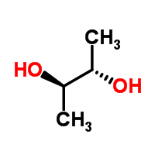
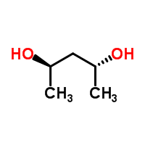
Naming Alcohols…
Name the following alcohols…
5
6
7
8

Slide 4
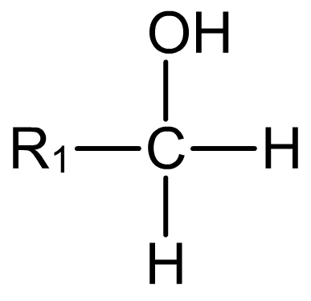
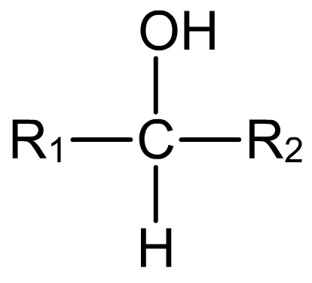
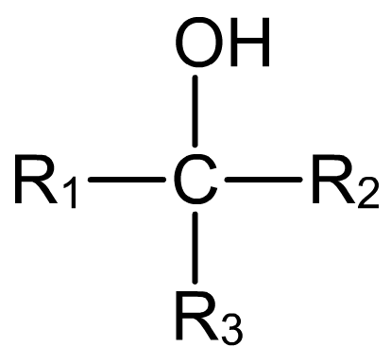
Primary, secondary and tertiary
A chain of carbon atoms can be represented by R when drawing the structure. This is referred to as an R group.
Primary (1°) alcohols have one R group attached to the carbon to which the OH group is attached.
Secondary (2°) alcohols have two R groups attached to the carbon to which the OH group is attached.
Tertiary (3°) alcohols have three R groups attached to the carbon to which the OH group is attached.

Slide 5
Reactions of alcohols
Combustion
Conversions to halogenoalkanes
Dehydration to alkenes

Slide 6
Ethanol as a fuel…
Picnic stoves burn methylated spirits
Methylated spirits – ethanol with a small percentage of poisonous methanol
Methanol makes it unfit to drink

Slide 7
Combustion
Write a balanced symbol equation for the complete combustion of the following alcohols:
Ethanol
Butan-2-ol
Propanol

Slide 8
Answers
C₂H₅OH + 3O₂ → 2CO₂ + 3H₂O
CH₃CH(OH)CH₂CH₃ + 6O₂ → 4CO₂ + 5H₂O
C₃H₇OH + 4.5O₂ → 3CO₂ + 4H₂O

Slide 9
Conversion to halogenoalkanes

Slide 10
Conversions to halogenoalkanes
Chlorination
Using phosphorus (V) chloride
White solid
Very vigorous reaction at room temperature
No need for heating
Two inorganic products made – phosphorus oxychloride and hydrogen chloride
CH₃CH₂CH₂OH + PCl₅ → CH₃CH₂CH₂Cl + POCl₃ + HCl

Slide 11
Conversions to halogenoalkanes
Chlorination of tertiary alcohols
Only to be mixed with concentrated HCl
Room temperature
(CH₃)₃COH + HCl → (CH₃)₃CCl + H₂O

Slide 12
Conversions to halogenoalkanes
Bromination
Using potassium bromide
And 50% concentrated sulfuric acid
Reaction mixture is warmed
Inorganic products react together to form HBr
KBr + H₂SO₄ → KHSO₄ + HBr
OR
2KBr + H₂SO₄ → K₂SO₄ + 2HBr

Slide 13
Conversions to halogenoalkanes
Bromination
Using potassium bromide
And 50% concentrated sulfuric acid
Reaction mixture is warmed
Inorganic products react together to form HBr
CH₃CH₂CH₂CH₂OH + HBr → CH₃CH₂CH₂CH₂Br + H₂O

Slide 14
Conversions to halogenoalkanes
Iodination
Using red phosphorus and iodine
Heated under reflux
Again, inorganic reagents first react to form phosphorus (III) iodide.
2P + I₂ → 2PI₃
3C₂H₅OH + PI₃ → 3C₂H₅I + H₃PO₃

Slide 15
What is meant by the term “Dehydration”?

Slide 16
Dehydration (removal of water) of alcohols
→ alkenes
H
OH
C
C
+ HOH
C
C
Removal (elimination) of water by :
Used to make ETHENE in countries where carbohydrate plentiful for fermentation
1. heating with concentrated phosphoric acid
but petroleum oil not available for cracking
NB H may be removed from more than one C adjacent to C-OH
→ mixture of alkenes

Slide 17
Deduce the dehydration products of : 1. Ethanol?
2. Methyl-propan-2-ol?
3. Butan-2-ol ?
1.
2.
3.
H
OH
H
H
H
OH
OH
H
H
C
C
H
H
C
C
CH₃
H
C
C
C
C
H
H
H
H
CH₃
H
H
H
H
H
H
H
CH₃
H
CH₂CH₃
C
C
C
C
C
C
+ HOH
H
H
H
CH₃
H
H
+ HOH
+ HOH
CH₃
H
cis & trans!
and
C
C
H
CH₃

Slide 18
Exam Questions

